Slide 1
Refining Your Project Schedule
Microsoft Project 2013
Lesson 4

Slide 2
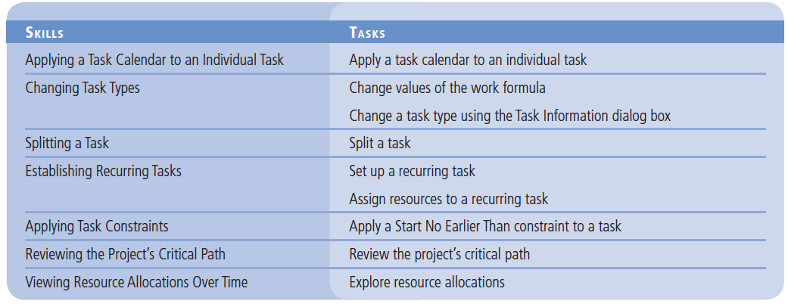
Objectives

Slide 3
Software Orientation
In Microsoft Project 2013, there may be times when you want specific tasks to occur at times that are outside the project calendar’s working time.
To do this, you need to create a new base calendar, a feature that is accessed through the Change Working Time dialog box.
This dialog box is accessed by clicking the Create New Calendar button in the Change Working Time dialog box, located on the Project ribbon.
The Create new base calendar dialog box enables you to name the new calendar, create a totally new calendar, or make a copy of an existing calendar on which to base your new calendar.

Slide 4
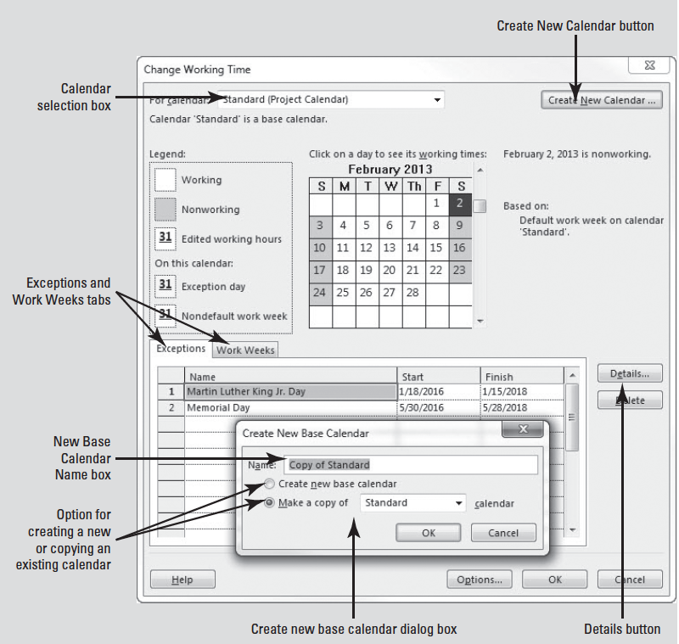
Software Orientation

Slide 5
Applying a Task Calendar to an Individual Task
When you set up resources in your project schedule, Microsoft Project created a specific calendar for each work resource.
Each resource calendar is based on another calendar, usually the project calendar.
Sometimes, you need a specific task to occur at a time that is outside the project calendar’s working time (such as overnight or on a weekend).
To do this, you can assign a task calendar to this task.
You can use one of Project’s base calendars, or you can create a new base calendar that fits your task requirements.

Slide 6
Assigning a Task Calendar to an Individual Task
A task calendar is a base calendar used by a single task for scheduling. It defines working and nonworking times for a task, regardless of settings in the project calendar.
Task calendars are often used when a task must run overnight, occur on a specific weekday, or occur over a weekend.
Task calendars are beneficial when other base calendars–such as the 24 Hours or Night Shift–are too broad or too specific for the task requirements.
In this exercise, you create and assign a task calendar to a task that occurs outside normal working times–an overnight video shoot.

Slide 7
Step by Step: Apply a Task Calendar to an Individual Task
GET READY. OPEN Don Funk Music Video 4M. SAVE the file as Don Funk Music Video 4.
1. Click the Project tab then click Change Working Time. The Change Working Time dialog box is activated.
2. In the Change Working Time dialog box, click the Create New Calendar button. The Create new base calendar dialog box appears as shown in figure on slide 4.
3. In the Name box, type Overnight Beach Filming. One of the scenes for the video will be shot during the overnight hours on a public beach.

Slide 8
Step by Step: Apply a Task Calendar to an Individual Task
4. If it is not already selected, click the Make a copy of button. In the drop-down list box, select Standard, and then click OK. (Refer back to the Software Orientation at the beginning of this lesson for more details on this screen.)
Note that you are now editing the newly created base calendar called “Overnight Beach Filming,” as indicated at the top of the dialog box, in the “For calendar:” box.
5. Click Work Weeks tab in the Change Working Time dialog box, and then click the Details button. The Details dialog box appears.
6. In the Select days box, drag your pointer to select Tuesday through Friday. Click the Set day(s) to these specific working times button.

Slide 9
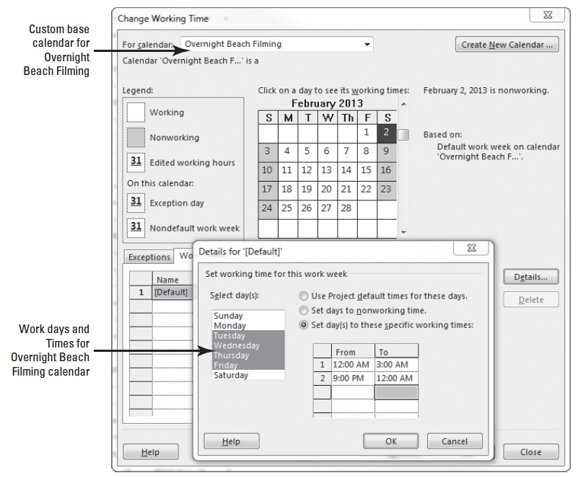
Step by Step: Apply a Task Calendar to an Individual Task
7. Click the cell in row 1 of the From column and type 12:00 AM. Click the cell in row 1 of the To column and type 3:00 AM. Click the cell in row 2 of the From column and type 9:00 PM. Click the cell in row 2 of the To column and type 12:00 AM. Press Enter. Your screen should look similar to the figure at right

Slide 10
Step by Step: Apply a Task Calendar to an Individual Task
8. In the Select days box, select Monday. Click the Set day(s) to these specific working times button. Click the cell in row 1 of the From column and type 9:00 PM. Click the cell in row 1 of the To column and type 12:00 AM. Click the cell in row 2 of the From column and press Delete.
9. Select Saturday. Click the Set day(s) to these specific working times button. Click the cell in row 1 of the From column and type 12:00 AM. Click the cell in row 1 of the To column and type 3:00 AM. Press Enter.
Notes:
ANOTHER WAY: To quickly bring information into view on a selected task, press the keystroke combination of Ctrl+Shift+F5.
TROUBLESHOOTING: Microsoft Project will not allow you to set a timeframe that spans two days. For instance, you cannot specify a working time for Monday of 9PM–3AM because 3AM is on Tuesday. You must set the time intervals for each specific day, as you did in this exercise.

Slide 11
Step by Step: Apply a Task Calendar to an Individual Task
10. Click OK to close the Details dialog box, then click OK to close the Change Working Time dialog box. You have now created and set the working times for this calendar from 9:00 PM to 3:00 AM from Monday night through Friday night (Saturday morning). Now you must assign the calendar to a task.
11. Select the name of task 35, Scene 3 video shoot. If the Gantt bar of this task is not visible, click the Scroll To Task button on the Task ribbon.
12. Click the Task tab then click the Information button in the Properties group. The Task Information dialog box appears.
13. Click the Advanced tab of the Task Information dialog box.

Slide 12
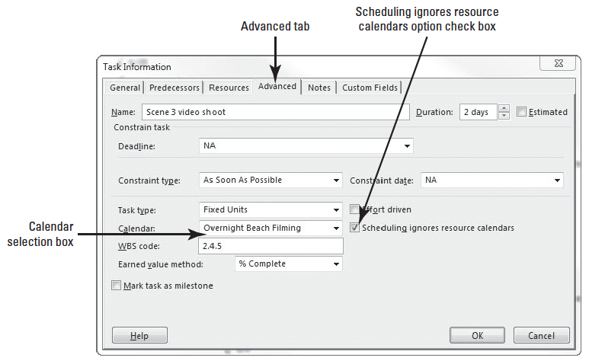
Step by Step: Apply a Task Calendar to an Individual Task
14. In the Calendar box, select Overnight Beach Filming from the drop-down list box. Click the Scheduling ignores resource calendars check box. Your screen should look like the figure below.

Slide 13
Step by Step: Apply a Task Calendar to an Individual Task
15. Click OK to close the Task Information dialog box. Microsoft Project applies the Overnight Beach Filming calendar to task 35, and a calendar icon appears in the Indicators column. Because you chose to ignore resource calendars, the resources for this task will be scheduled at times that would usually be nonworking times for them.
16. SAVE the project schedule.
PAUSE. LEAVE the project schedule open to use in the next exercise.
Notes:
Take Note: You will notice that a small, red human icon appears in the Indicators column. This is a feature that notifies the user of a resource over allocation, which will be discussed later in this chapter.

Slide 14
Step by Step: Apply a Task Calendar to an Individual Task
You have just created and assigned a task calendar to a task that occurs outside normal working times–an overnight video shoot.
For tasks that have both a task calendar and resource assignments (and therefore a resource calendar), Microsoft Project will schedule work in the working time that is common between the task and resource calendar(s).
If there is no common time, Project will alert you when you assign a resource to the task or when you apply the task calendar.

Slide 15
Changing Task Types
As you learned in lesson 3, Microsoft Project uses the formula: Duration X Units = Work, called the work formula.
The task type specifies which value in the formula remains fixed if one of the other two values changes.
To determine which task type is the right one to apply to each task in your project schedule, you first need to determine how you want Project to schedule that task.
Duration X Units = Work

Slide 16
Task Types and the Effect of the Work Formula
The default task type is fixed units, which means the units value does not change. With the fixed units task type, if you change a task’s duration, Microsoft Project recalculates work. If you change work, duration is recalculated.
A fixed duration task is one in which the duration value is fixed. If you change the task’s work or units value, Project recalculates the other value.
A fixed work task is one in which the work value is held constant. You can change the duration or units and Project will determine the other value. Project has a bias towards changing duration first. If it cannot change Duration, it will change Work and then Units.
Duration X Units = Work

Slide 17
Step by Step: Change Values of the Work Formula
In this exercise, you will examine the relationship between the work formula and task type.
USE the project schedule you created in the previous exercise.
1. Click the View tab. Click the Task Usage button in the Task Views group on the ribbon. The Task Usage View replaces the Gantt Chart view.
2. Press the F5 key. In the ID box, type 4, and then click OK. Microsoft Project shifts the project schedule so that task 4, Develop scene blocking and schedule, and its assignments are visible.
Duration X Units = Work

Slide 18
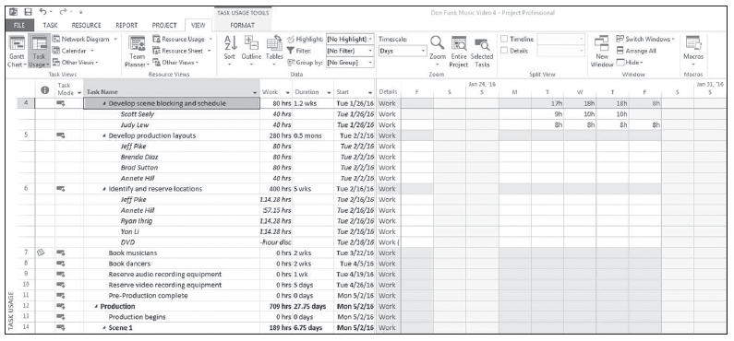
Step by Step: Change Values of the Work Formula
3. Auto fit the Task Name column and move the center divider to the right until you can see the Start column. To auto fit a column, place the pointer on the right side dividing line of the column name and double-click. Your screen should look similar to the figure below.
Duration X Units = Work
Notes:
Take Note: If a task type is fixed, this doesn’t mean that its units, work, or duration values are unchangeable. You can change any value for any task type.

Slide 19
Step by Step: Change Values of the Work Formula
5. Right-click the Start column heading. Select Insert column.
You can search from the drop-down list that appears for the field labeled Assignment Units. You can also start typing the word “assignment” and the list will be reduced in size.
Select the Assignment Units field when it appears. Note that task 4 has a total work value of 80 hours, 40 work hours and 100 percent resource units for each of two resources, and a duration of 1.2 weeks.
Your team has determined that this task’s duration should be two weeks, but the work necessary to complete the task should remain the same.
Duration X Units = Work

Slide 20
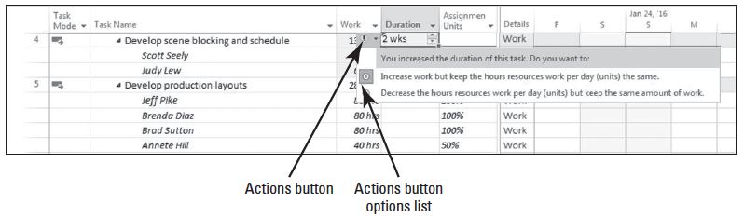
Step by Step: Change Values of the Work Formula
6. In the Duration field for task 4, select or type 2w, and press Enter. Microsoft Project changes the duration of task 4 to two weeks and increases the work for each resource. You want to increase the duration but keep the work the same.
7. Point to the Duration field for task 4, and then click on the Actions button. Your screen should look similar to the figure below.
Duration X Units = Work

Slide 21
Step by Step: Change Values of the Work Formula
Review the options in the Smart Tag list. The task type for task 4 is fixed units (the default task type), so the default selection in the Actions options list is to increase work as the duration increases.
Based on your team’s discussions, you want to keep the work value constant and decrease assignment units for the task’s new duration.
Duration X Units = Work

Slide 22
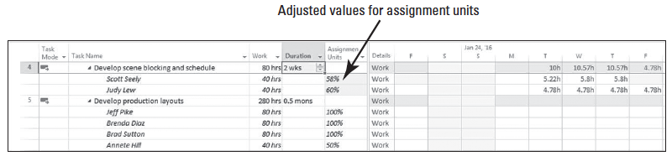
Step by Step: Change Values of the Work Formula
8. Select Decrease the hours resources work per day (units) but keep the same amount of work in the Actions list. The total work on the task is still 80 hours, but the assignment units value of each resource decreases. Another way to think of this is that the resources will put in the same total effort over a longer period of time. The figure below shows the adjusted scheduling formula values for task 4.

Slide 23
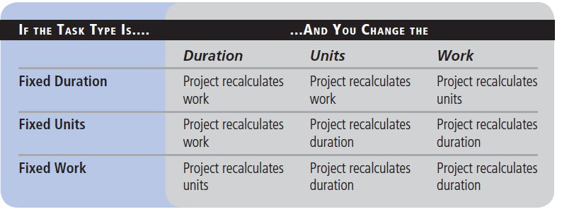
Step by Step: Change Values of the Work Formula
9. SAVE the project schedule.
PAUSE. LEAVE the project schedule open to use in the next exercise.
The table below highlights the effect of changing any scheduling formula variable for any task type
Duration X Units = Work
Notes:
Troubleshooting: As you fine-tune your project schedule, keep in mind that you cannot turn off effort-driven scheduling for a fixed work task.
Take Note: To see the task type of a task you have selected, click the Information button on the Task ribbon, and then click the Advanced tab in the Task Information dialog box. You can also see the task type when you are in the Gantt Chart view via the Task Form. On View ribbon, click Details in the Split View group. The Task form will appear in the lower portion of your screen.

Slide 24
Using the Task Information Dialog Box to Change a Task Type
In the previous exercise, you changed the way Project behaved (from its default action) by using the Actions button.
In this exercise, you will change the task type using the Task Information dialog box then change one of the values of units, duration, and work and allow the software to perform its normal actions.

Slide 25
Step by Step: Change a Task Type Using the Task Information Dialog Box
USE the project schedule you created in the previous exercise.
1. Switch back to the Gantt Chart view by clicking on the Gantt Chart button in the View ribbon.
2. Press the F5 key. In the ID box, type 6, and then click OK.
3. Double-click Task 6. The Task Information dialog box appears.
4. Click the Advanced tab if it is not already selected. Note that in the Task type box the task has a Fixed Units task type. You need to adjust this task’s resources, but leave its duration fixed at 5 weeks.

Slide 26
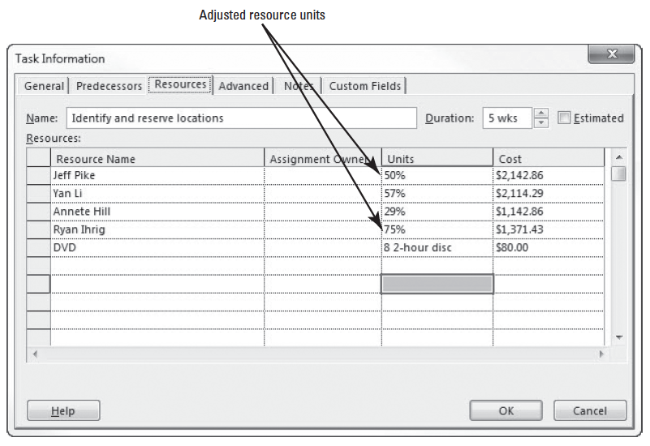
Step by Step: Change a Task Type Using the Task Information Dialog Box
5. Select Fixed Duration from the drop-down list box in the Task type box.
6. Click the Resources tab on the Task Information dialog box.
7. In the Units column, set the units value for Jeff Pike to 50% and for Ryan Ihrig to 75%. Your screen should look similar to the figure at right.

Slide 27
Step by Step: Change a Task Type Using the Task Information Dialog Box
8. Click OK to close the Task Information dialog box. Note that the duration of the task did not change.
9. SAVE the project schedule.
PAUSE. LEAVE the project schedule open to use in the next exercise.
Notes:
Take Note: You cannot change the task type on a summary task–it is always fixed duration. This is because the summary task is based on the earliest start date and the latest finish date of its subtasks.

Slide 28
Step by Step: Change a Task Type Using the Task Information Dialog Box
As you are fine-tuning your project schedule, keep in mind that it is easy to confuse task type and effort-driven scheduling.
They are similar in that they both affect work, duration, and units values.
The key difference is that effort-driven scheduling affects your schedule only when you add or remove resources from tasks, while task type affects your schedule when you change the value of units, duration, or work.

Slide 29
Splitting a Task
Sometimes, work on certain tasks in a project schedule will stop and then start again, and these interruptions may be planned or unplanned.
You split a task to show that work has been interrupted and restarted.
A split is an interruption in a task, represented in Project’s Gantt bar by a dotted line between the two segments of the task.
In this exercise, you practice splitting a task to represent some nonworking time in the middle of the task.

Slide 30
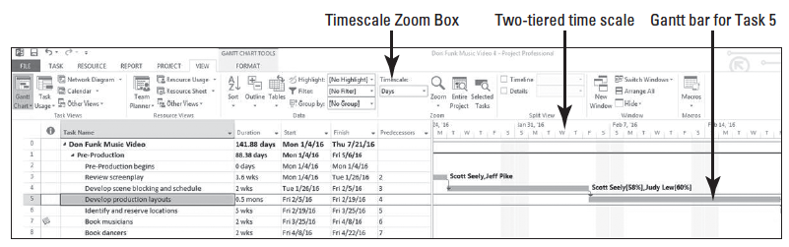
Step by Step: Split a Task
USE the project schedule you created in the previous exercise.
1. Select the name of task 5, Develop production layouts.
2. Press Ctrl+Shift+F5. Microsoft Project brings the Gantt bar of task 5 into view.
3. Click on the View tab. In the Zoom command group, in the selection box below Timescale, select Days. Your screen should look similar to the figure below. You have just been told that work on this task will be interrupted from February 9 to February 11 (no work will occur on these days).
Notes:
Take Note: The timescale at the top of the right half of the Gantt Chart (above the graphical bars) determines at what level of time (months, weeks, days, etc.) you can split a task. The calibration of the bottom tier of the timescale is the smallest increment into which you can split a task. In this exercise, you can split a task into one-day increments because days are on the bottom tier. If you wanted to split a task at the hourly level, you would need to adjust the Timescale option on the View ribbon.

Slide 31
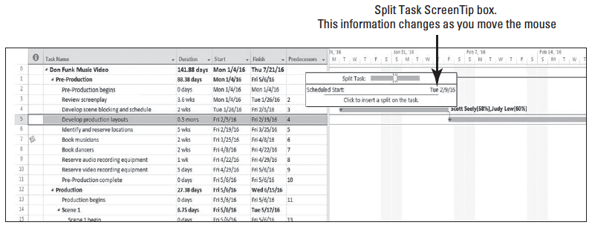
Step by Step: Split a Task
4. Right-click the Gantt bar for task 5. From the shortcut menu that appears, click the Split Task button from the upper shortcut menu. A ScreenTip appears and the mouse pointer changes to a double vertical line with an arrow to the right.
5. Move the mouse pointer over the Gantt bar of task 5. Watch the ScreenTip box as you move the pointer–the date changes. The ScreenTip box reflects the date on which you will begin to split the task. Your screen should look similar to the figure below.

Slide 32
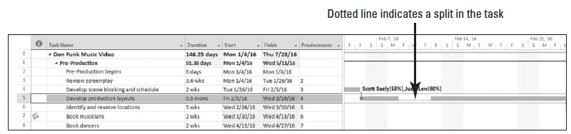
Step by Step: Split a Task
6. Move (but don’t click) the mouse pointer over the Gantt bar until the Start date of Tuesday, 2/9/16, appears in the ScreenTip box.
7. Click and hold, then drag the mouse pointer to the right until the Start date of Friday, 2/12/16, appears in the ScreenTip, and then release the mouse button. Microsoft Project inserts a task split between the two parts of the task. The split, or interruption in work, is represented by a dotted line in the Gantt Chart, as shown in the figure below.
Notes:
Troubleshooting: Splitting tasks using the mouse pointer takes a little practice. If you split a task on the wrong date, there are two ways you can correct it. First, you can click the Undo button on the menu bar to remove the incorrect split. Or, point to the second segment of the task again, and when the mouse pointer changes to a circle with four arrows, drag the segment to the correct start date. You can drag multiple times.

Slide 33
Step by Step: Split a Task
8. SAVE the project schedule.
PAUSE. LEAVE the project schedule open to use in the next exercise.
Keep the following points in mind when splitting a task:
You can split a task into as many parts as necessary.
You can drag a segment of a split task either right or left to reschedule the split.
The time of the actual task split, represented by the dotted line, does not count in the duration of the task unless the task type is fixed duration. Work does not occur during the split.
If the duration of a split task changes, the last segment of the task is lengthened or shortened.
If a split task is rescheduled, the whole task, including the splits, is rescheduled. The same pattern of segments and splits is preserved.
Notes:
Cross Ref: Resource leveling or manually contouring assignments can also cause tasks to split. You can find out more about resource leveling in Lesson 6 and about contouring assignments in Lesson 13.

Slide 34
Establishing Recurring Tasks
Many projects require repetitive tasks, such as a status meeting or cleaning a production line.
Even though these may seem like negligible tasks, you should account for them in your project schedule because they require time from project resources and therefore have costs associated with them.
A recurring task is a task that is repeated at specified intervals, such as daily, weekly, or monthly.
When you create a recurring task, Microsoft Project creates a series of tasks with Start No Earlier Than constraints, no task relationships, and effort-driven scheduling turned off.
In this exercise, you will learn how to set up a task that will repeat at a specified interval during the project.

Slide 35
Step by Step: Set Up a Recurring Task
USE the project schedule you created in the previous exercise.
1. Select the name of task 11, Pre-Production complete. You want to insert the recurring tasks as the last items in the Pre-Production phase.
2. On the Task ribbon, in the Insert group, click the down-arrow under the Task button. Select Recurring Task. The Recurring Task Information dialog box appears.
3. In the Task Name box, type Status Meeting.
4. In the Duration box, type 1h.
5. Under Recurrence Pattern, make sure that Weekly is selected, and then select the Monday check box.

Slide 36
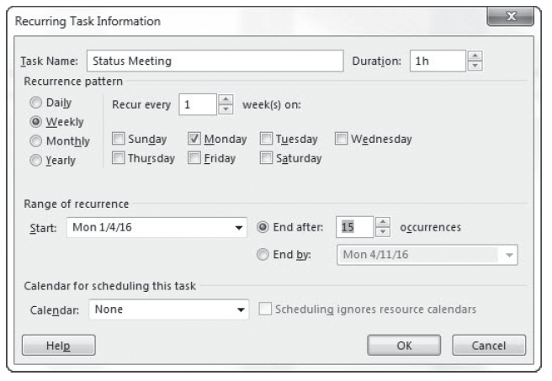
Step by Step: Set Up a Recurring Task
6. In the Start box, type or select 1/4/16. The first occurrence of your weekly meeting will be on January 4, 2016.
7. Under Range of recurrence, click End after, and then type or select 15 occurrences. Your screen should look like the figure above.
Notes:
Take Note: Microsoft Project schedules a recurring task to start at the Default Start Time value you established at the beginning of your project. To schedule a recurring task to begin at a different time, enter that time along with the start date in the Start box of the Recurring Task Information dialog box. For instance, if you want the status meeting to start at 9 A.M. on January 17, you would enter 1/17/16 9 AM in the Start box.

Slide 37
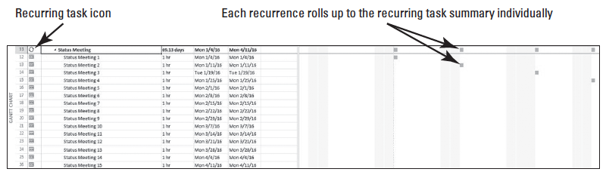
Step by Step: Set Up a Recurring Task
8. Click OK to create the recurring task. A Microsoft Project dialog box appears to notify you that one of the instances of the recurring task will occur during nonworking times (the holiday on January 18).
9. Review the options presented in the dialog box. You want to reschedule the status meeting for this particular week. Click Yes to reschedule this occurrence of the task. Microsoft Project inserts the recurring tasks within the Pre-Production phase. A recurring task icon appears in the Indicators column, as shown below.

Slide 38
Step by Step: Set Up a Recurring Task
10. Click the name of task 11, Status Meeting, and then click the Scroll to Task button in the Editing group on the Task ribbon. The Gantt Chart displays the first occurrences of the recurring meeting’s Gantt bars. Notice that the Gantt bar at the recurring task level (task 11) task shows only the individual occurrences of the tasks. This is because a recurring task is not a true summary task.
11. SAVE the project schedule.
PAUSE. LEAVE the project schedule open to use in the next exercise.

Slide 39
Step by Step: Assign Resources to a Recurring Task
USE the project schedule you created in the previous exercise.
1. If it is not already selected, click the name of task 11, Status Meeting.
2. Click the Resource tab. In the Assignments group on the ribbon, click Assign Resources.
3. In the Assign Resources dialog box, click Brad Sutton. Then hold down Ctrl while clicking Chris Preston, Eva Corets, Jamie Reding, Jane Clayton, and Judy Lew.
4. Click Assign, and then click Close. Microsoft Project assigns the selected resources to the recurring task.

Slide 40
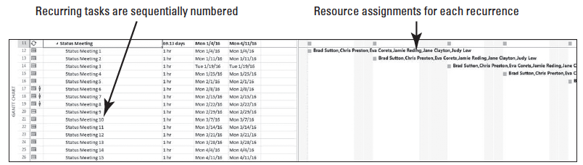
Step by Step: Assign Resources to a Recurring Task
5. If the recurring task is not already expanded, click the Expand button next to task 11’s title to show the subtasks. Your screen should look similar to the figure below.
6. Click the Collapse button next to task 11’s task title to collapse the subtasks under the recurring task.
7. SAVE the project schedule.

Slide 41
Step by Step: Assign Resources to a Recurring Task
PAUSE. LEAVE the project schedule open to use in the next exercise.
Keep the following points in mind when establishing a recurring task:
You can only use the Assign Resources dialog box when assigning resources to all recurring tasks at the same time. If you enter resource names in the Resource Name field of the summary task, the resources will only be assigned to the summary task, not to the individual occurrences.
If you schedule a recurring task to end on a specific date, Microsoft Project will suggest the current project end date. If you select the project end date, you will need to manually change it later if the project end date changes.
As you saw in this exercise, Microsoft Project will alert you if an occurrence of a recurring task will take place during nonworking time. You can choose to skip that occurrence or to schedule it for the next working day.

Slide 42
Applying Task Constraints
Every task that you enter into your project schedule has some type of limit, or constraint, applied to it.
The constraint controls the start or finish date or the extent to which the task can be adjusted. There are three categories of constraint, and each has very different effects on the scheduling of tasks.
A flexible constraint gives Project the ability to change start and finish dates (this is the default type).
An inflexible constraint forces a task to begin or end on a specific date, and should be used only when necessary.
A semi-flexible constraint gives Project the ability to change task start and finish dates (but not duration) within one date boundary.

Slide 43
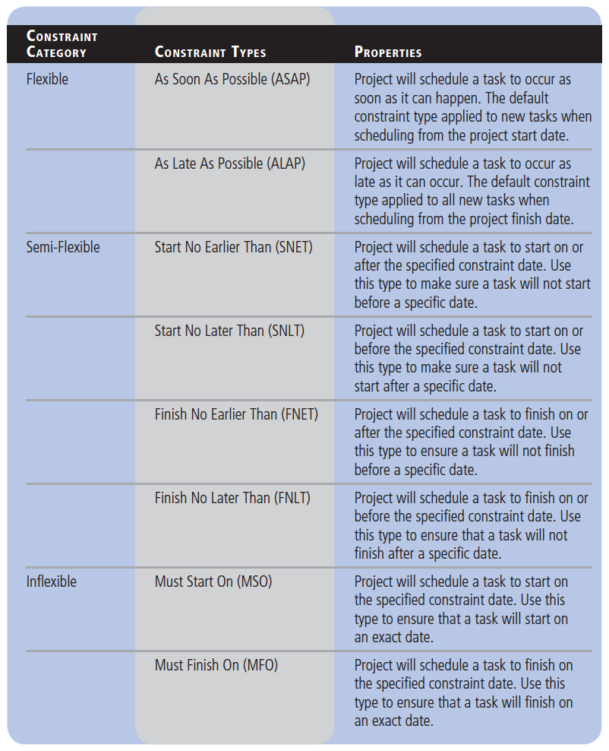
Applying Task Constraints
The table at right shows the eight types of task constraints within the three constraint categories.
In this exercise, you apply a constraint to a task in Microsoft Project.

Slide 44
Step by Step: Apply a Start No Earlier Than Constraint to a Task
USE the project schedule you created in the previous exercise.
1. Press the F5 key. In the ID box, type 39 and press Enter. This scene will be shot at a location that is not available until May 25, 2016.
2. Double-click on Task 39. The Task Information dialog box appears.
3. Click on the Advanced tab. In the Constraint task section, next to Constraint type, select Start No Earlier Than from the drop-down list box.

Slide 45
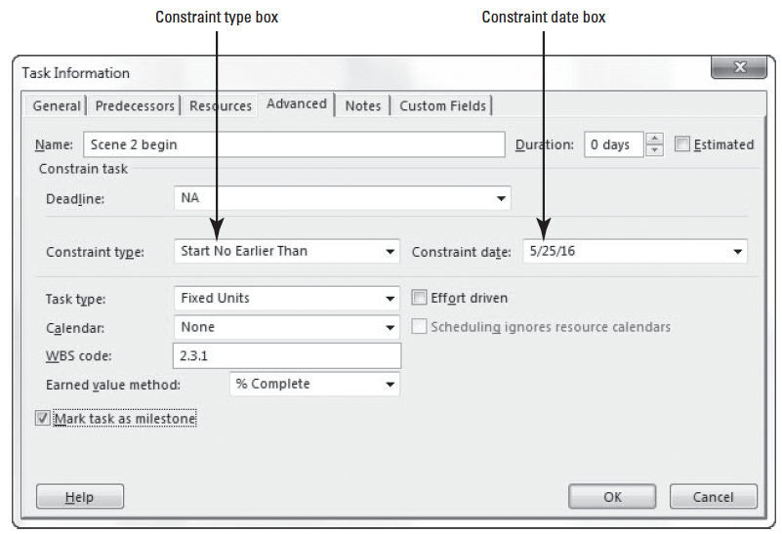
Step by Step: Apply a Start No Earlier Than Constraint to a Task
4. In the Constraint date box, type 5/25/16. Your screen should look similar to the figure below.
Notes:
Take Note: Unless you specify otherwise, Microsoft Project schedules the start or finish time of a constraint date using the Default Start Time or Default End Time value you established at the beginning of your project (on the ribbon click File, then select Options, then click the Schedule section).

Slide 46
Step by Step: Apply a Start No Earlier Than Constraint to a Task
5. Click OK. Note the highlighted cells showing the effect of this change. Widen the table as necessary to view additional data columns. The constraint is applied and a constraint icon appears in the Indicators column. When you point to the icon, constraint details will be shown in a ScreenTip. The task is rescheduled to start on May 25, and all other tasks that depend on task 38 are also rescheduled.
6. SAVE the project schedule.
PAUSE. LEAVE the project schedule open to use in the next exercise.
Keep the following points in mind when setting constraints for tasks:
To remove a constraint, double-click the task from which you want to remove the constraint. In the Task Information dialog box, click the Advanced tab. In the Constraint type box, select As Soon As Possible (if scheduling from start date) or As Late As Possible (if scheduling from finish date).
Notes:
Troubleshooting: Avoid entering task start and finish dates unless absolutely necessary. When you enter start or finish dates, Project applies semi-flexible constraints such as Start No Earlier Than or Finish No Earlier Than, which prevents the project manager from taking advantage of the Microsoft Project scheduling engine.

Slide 47
Step by Step: Apply a Start No Earlier Than Constraint to a Task
If you try to apply inflexible or semi-flexible constraints to tasks in addition to task links, you might create what is known as negative float—or negative slack—the amount of time that tasks overlap due to a conflict between task relationships and constraints.
For example, a task with a Must Start On (MSO) constraint for April 24 and a finish-to-start relationship to another task will always be scheduled for April 24, no matter when its predecessor finishes.
To set Microsoft Project to honor relationships over constraints, select the File ribbon, click Options, and then click the Schedule option. Under Schedule Options for this project, clear the Tasks will always honor their constraint dates check box.

Slide 48
Step by Step: Apply a Start No Earlier Than Constraint to a Task
Some constraint behaviors change if you must schedule a project from a finish date rather than a start date. For instance, the ALAP constraint type becomes the default for new tasks, rather than ASAP. Pay close attention to the constraints you apply in this case to make sure the results are what you expected.
It is considered a best practice to insert a note on a task that has a constraint applied.
The reasoning for this is simple–communication. By entering a note, anyone who views the schedule will see why a constraint is applied. In lesson 1 you learned how to insert a note on a task.

Slide 49
Step by Step: Apply a Start No Earlier Than Constraint to a Task
Another feature in Microsoft Project 2013 that is helpful in reviewing constraints, assignments, and dependencies is the Task Inspector.
The Task Inspector looks at the task drivers show the factors that drive a task’s start times and help you backtrack to analyze the constraints.
You can use the Task Inspector to determine the factor(s) driving the start date of a task or follow a chain of factors to find the cause of a delay you are tracking.
You can access Task Inspector by clicking the Task ribbon, then click Inspect in the Tasks group.

Slide 50
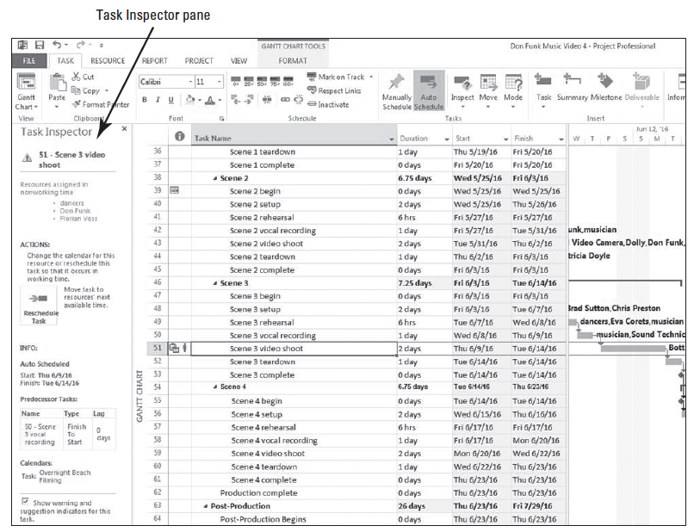
Step by Step: Apply a Start No Earlier Than Constraint to a Task
The Task Inspector pane will appear on the left side of your screen. The figure at right shows the Task Inspector pane activated for task 51.

Slide 51
Reviewing the Project’s Critical Path
In every project, there is a series of tasks, known as the critical path, that directly affect the finish date of the project.
If any one of these tasks is delayed, either in the start or completion of, the finish date of the project will be delayed.
The term “critical” refers not to the importance of the tasks in the critical path, but rather to the impact that the scheduling of these tasks have on the finish date of the project.
One of the best ways to shorten the overall duration of a project is to shorten its critical path.
In Project 2013, you can review your project’s critical path, including any existing free slack—the amount of time a task can be delayed before it will delay another task.
In this exercise, you review your project’s critical path.

Slide 52
Step by Step: Review the Project’s Critical Path
USE the project schedule you created in the previous exercise.
1. Click the Task tab, and then click the down-arrow under the Gantt Chart button; the view list appears. Select More Views.
2. In the More Views dialog box, select Detail Gantt, and then click the Apply button. The project schedule is displayed in the Detail Gantt view.

Slide 53
Step by Step: Review the Project’s Critical Path
3. Press the F5 key. The Go To dialog box appears. In the ID box, type 50, and then click OK. The view shifts so that the Gantt bar for task 50 is visible. Scroll down so that most of the tasks after task 50 are visible, and you can see more of the critical path. Your screen should look similar to the figure on the next slide. Almost all of the tasks that fall after task 50, Scene 3 vocal recording, are on the critical path, which is shown in red. Noncritical tasks are displayed in blue and also show free slack. (Total slack is shown as the thin bar that extends to the right of the task bar.)

Slide 54
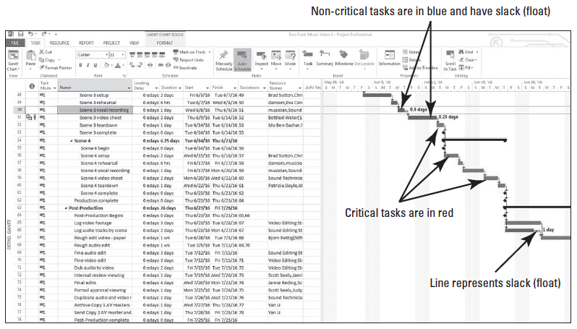
Step by Step: Review the Project’s Critical Path

Slide 55
Step by Step: Review the Project’s Critical Path
4. SAVE the project schedule.
PAUSE. LEAVE the project schedule open to use in the next exercise.
To fully understand the critical path concept, there are a few other terms with which you need to become familiar.

Slide 56
Step by Step: Review the Project’s Critical Path
Microsoft Project uses the term slack for the term float.
Float (or slack) is the amount of time a task can be delayed without causing a delay to another task or the overall project.
Free Float (or Free slack) is the amount of time a task can be delayed before it will delay another task.
Total Float (or Total Slack) is the amount of time a task can be delayed without delaying the project end date.
A task is usually considered to be on the critical path if its total float is zero (or occasionally, less than some specified amount).
Conversely, noncritical tasks have float greater than zero. Their start or finish dates can vary within their slack amounts without affecting the finish date of the project.

Slide 57
Viewing Resource Allocations Over Time
As a project manager, you are responsible for distributing work among the people and equipment resources of the project.
Allocation is the portion of a resource’s capacity devoted to work on a specific task.
Allocation is how you manage these resources and their assignments over time.
You need to be able to review each resource’s allocation, identify any problems that are evident, and adjust allocations as needed.
In this exercise, you will review your resources to identify resource allocation issues.

Slide 58
Step by Step: Explore Resource Allocations
USE the project schedule you created in the previous exercise.
1. On the Task ribbon, in the View group, click the down-arrow under the Gantt Chart button. Select More Views.
2. In the More Views dialog box, locate and select the Resource Allocation view. Click Apply. A split view appears: the Resource Usage view is on the top and the Leveling Gantt Chart view is at the bottom.

Slide 59
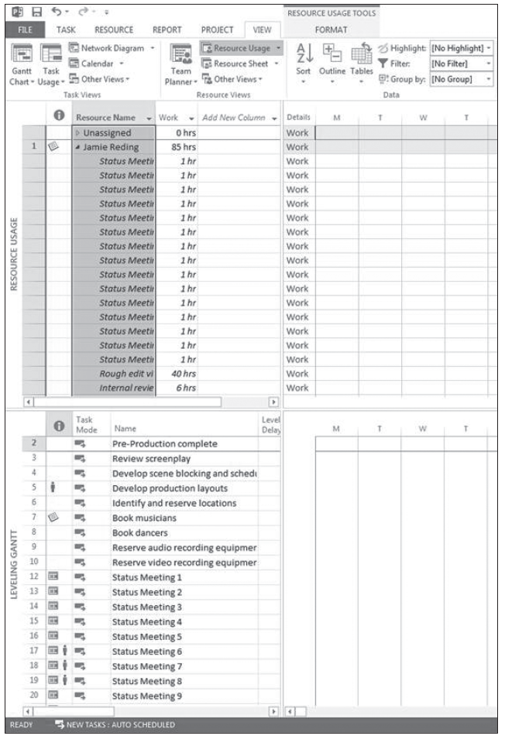
Step by Step: Explore Resource Allocations
3. Click the Resource Name column heading to highlight all cells in that field. Your screen should look similar to the figure at right.
4. Click on the View tab. In the Data group, click the Outline button, and then select Hide Subtasks. Microsoft Project collapses the Resource Usage view.

Slide 60
Step by Step: Explore Resource Allocations
5. Press Ctrl+Shift+F5. The resources’ total work values over the project timescale appear in the grid on the right. In the Resource Name column, click the task name cell Unassigned. Your screen should look similar to the figure on the next slide. To the left of the Resource Usage view is the Usage Table, which shows the assignments grouped by resource, the total work assigned to each resource, and the work for each assignment. The outline format can be expanded and collapsed. The right side of the view contains assignment details (default setting is work) displayed on a timescale.

Slide 61
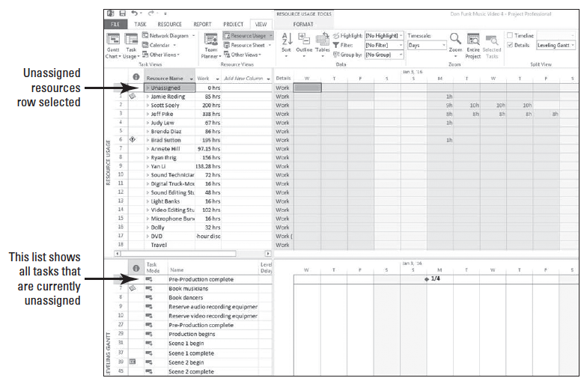
Step by Step: Explore Resource Allocations

Slide 62
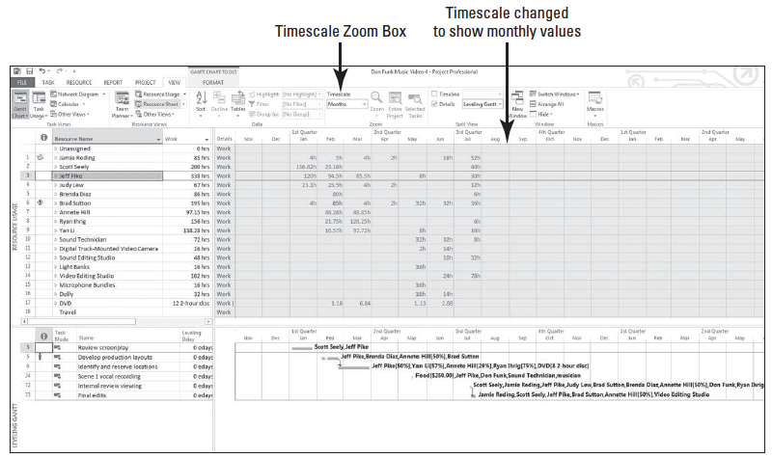
Step by Step: Explore Resource Allocations
6. Auto fit the Resource Name and Work columns. Then, in the Resource Name column, click on the name of resource 3, Jeff Pike. Note at the bottom of the screen, the Leveling Gantt view shows the actual tasks to which Jeff is assigned.
7. Click the View tab. In the Zoom group, click the down- arrow below to the Timescale units box and select Months. The time- scaled grid now shows work values per month. Your screen should look similar to the figure above.
Notes:
Take Note: Don’t worry if you see a resource group titled Unassigned. Sometimes there are tasks that have no specific resources assigned to them. These tasks are grouped together in this view and listed as a resource named Unassigned.
Another Way: Instead of using the Timescale command to change the tiers of the timescale, you can click the Zoom slider located at the lower right of your screen. If this method doesn’t give you the level of detail you need, then you can use the Timescale command.

Slide 63
Step by Step: Explore Resource Allocations
8. SAVE the project schedule. CLOSE the project schedule.
PAUSE. If you are continuing to the next lesson, keep Project open. If you are not continuing to additional lessons, close Project.
As the project manager, the decisions you make regarding task assignments affect the workloads of the resources on the project.

Slide 64
Step by Step: Explore Resource Allocations
Every resource is said to be in one of three states of allocation:
Under allocated—the work assigned to a resource is less than the resource’s maximum capacity. For example, a full-time resource who has only 20 hours of work assigned in a 40-hour work week is under allocated.
Fully allocated—the condition of a resource when the total work of its task assignments is exactly equal to that resource’s work capacity. For example, a full-time resource assigned to work 40 hours per week is fully allocated.
Over allocated—the work assigned to a resource is more than the resource’s maximum capacity. For example, a full-time resource that has 55 hours of work assigned in a 40-hour work week is over allocated.

Slide 65
Step by Step: Explore Resource Allocations
Allocating resources takes a combination of skill and common sense.
It might seem straight-forward to say that all resources should be fully allocated all of the time, but this is not always possible, practical, or even desirable.
There are situations in which over allocation or under allocation is quite acceptable. As the project manager, you must learn how to identify allocation problems and how to handle them.

Slide 66
Step by Step: Explore Resource Allocations
You might want to also keep the following points in mind when reviewing resource allocation:
In the Resource Usage view, the default table is the Usage table. You can display other table views by clicking the View tab, then clicking Usage in the Table command group and selecting the table you want to display.
Work values are the default in the time-scaled grid of the Resource Usage view. To display other assignment values, such as cost, click the Format tab, then click Details, and select the value you want to display.

Slide 67
Skill Summary

